Slide 1



Slide 2
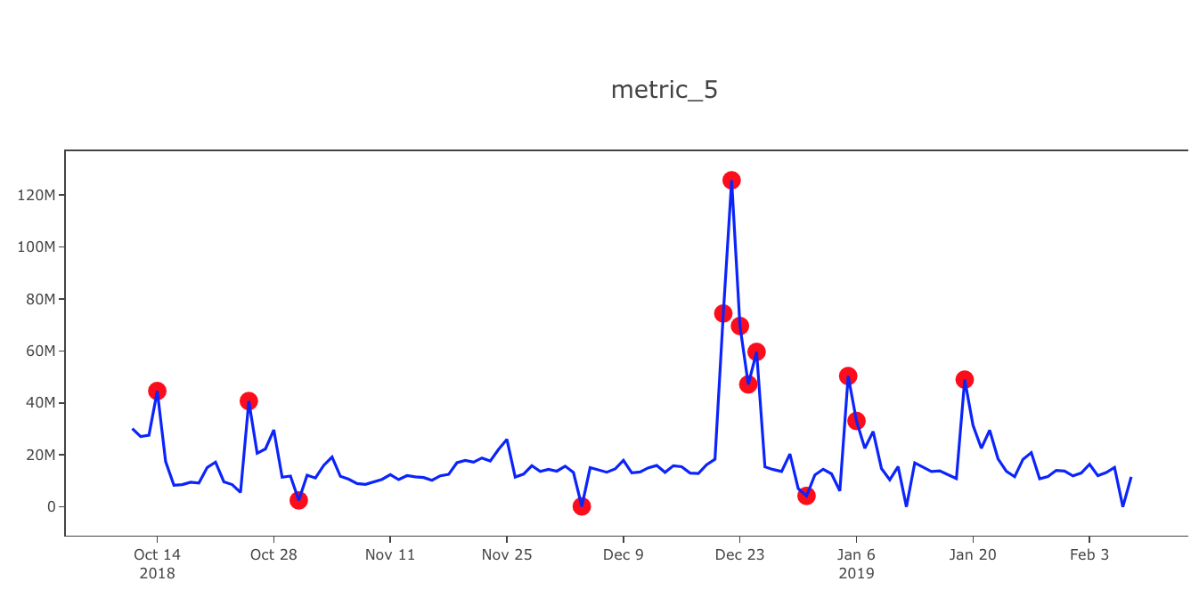
Anomaly Detection

Slide 3
AGENDA
1. Business context and objective
2. Translating into DS approach
a. What, why, where Anomaly Detection ?
b. Why we are using fraud dataset for this problem
c. Algorithms used to solve this problem
3. Data importing and Data Understanding
4. Data Pre processing – Creating time variable
5. EDA
6. Preparing data for modelling
7. Understanding neural networks and deep neural networks
8. Understanding auto encoders
9. Unsupervised Learning using h2o, Building model and Model Details
10. Evaluation parameters understanding, Evaluation, Anamoly Detection Visualization based in Reconstructed MSE
11. Supervised Learning using h2o ,Building model and tuning
12. Reconstructed MSE and decision boundary, Evaluation
13. Transfer learning : Supervised Learning using Pre trained model, Evaluation
14. Precision-recall curve, Try different threshold to improve accuracy
15. Making production ready code
16. Conclusion

Slide 4
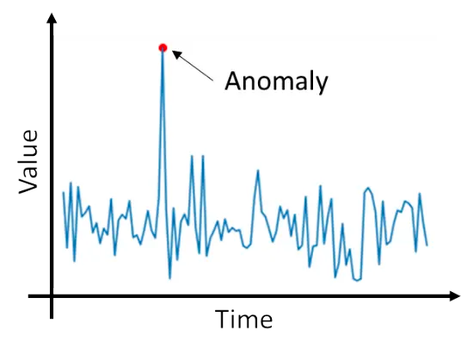
What is anomaly detection?
Anomaly detection (aka outlier analysis) is a step in data mining that identifies data points, events, and/or observations that deviate from a dataset’s normal behaviour. Anomalous data can indicate critical incidents, such as a technical glitch, or potential opportunities, for instance a change in consumer behaviour.

Slide 5
Why anomaly detection?
Banking, Financial Services, and Insurance (BFSI) – In the banking sector, some of the use cases for anomaly detection are to flag abnormally high transactions, fraudulent activity, and phishing attacks.
Retail – In Retail, anomaly detection is used for processing large volumes of financial transactions to identify fraudulent behaviors, such as identity theft and fraudulent credit card usage.
Manufacturing – In Manufacturing, anomaly detection can be used in a number of important ways, such as identifying machines and tools that are underperforming, which can take months to find without anomaly detection technology.
IT and Telecom – In IT and Telecommunications, anomaly detection is increasingly valuable to detect and act on personal threats to users, financial threats to service providers, or other types of unexpected threats.
Defence and Government – In Defence and Government setting, anomaly detection is best used for identifying excessive and fraudulent government spending, budgeting, and audits. This can save governments an immense amount of money.
Healthcare – In Health Care, anomaly detection is used for its application in a crucial management task that can improve the quality of the health services and avoid loss of huge amounts of money. In terms of identifying fraudulent claims from hospitals and on the side of the insurance providers.

Slide 6
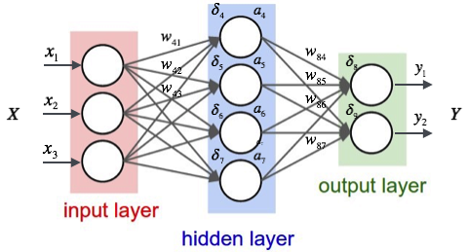
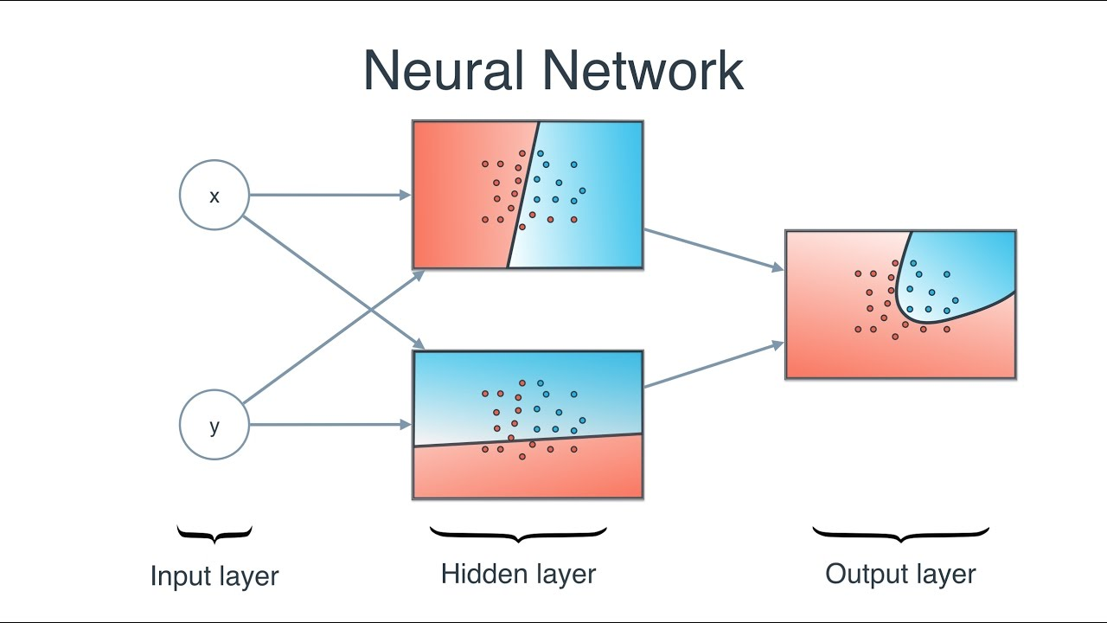
Neural Networks
y = mx + c
Naturally, the right values for the weights and biases determines the strength of the predictions. The process of fine-tuning the weights and biases from the input data is known as training the Neural Network.
Calculating the predicted output ŷ, known as feedforward
Updating the weights and biases, known as backpropagation
Objective in training is to find the best set of weights and biases that minimizes the loss function using the optimizer like gradient descent..
Activation functions are non-linear complex functional mappings between the inputs and response variable. They introduce non-linear properties to our Network.

Slide 7

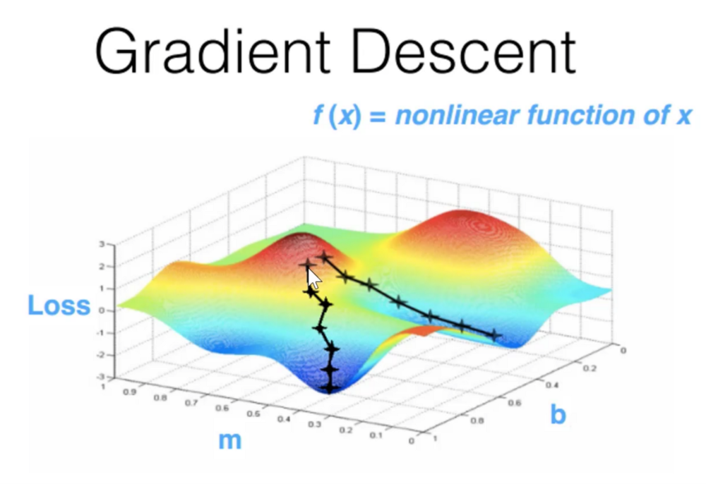
Neural Networks
Weights
Bias
Loss function
Optimizers – Gradient Descent, Adam, AdaDelta, RMS Prop
Activation functions – Sigmiod, Softmax, ReLU
Learning rate

Slide 8
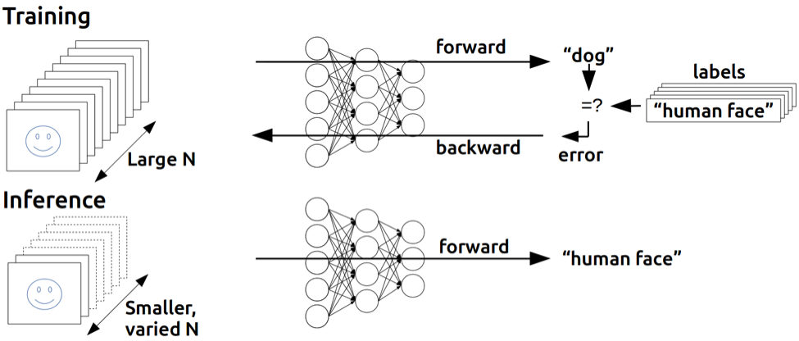
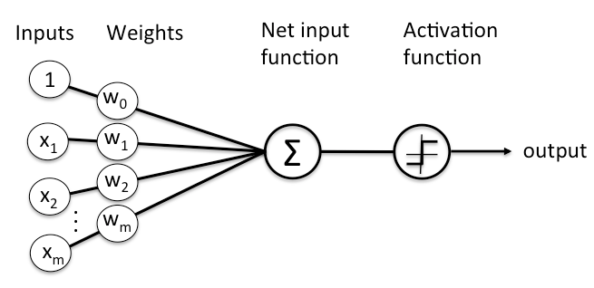
Deep Neural Networks
Number of hidden layers is more than one
each layer of nodes trains on a distinct set of features based on the previous layer’s output
aggregate and recombine features from the previous layer.
It makes deep-learning networks capable of handling very large, high-dimensional data sets with billions of parameters that pass through non linear functions
these nets are capable of discovering latent structures within unlabeled, unstructured data, which is the vast majority of data in the world

Slide 9

What is autoencoders?
Autoencoder is an unsupervised artificial neural network that learns how to efficiently compress and encode data then learns how to reconstruct the data back from the reduced encoded representation to a representation that is as close to the original input as possible. Autoencoder, by design, reduces data dimensions by learning how to ignore the noise in the data.
In autoencoders, there are three main building blocks: encoder, decoder, and coder or latent space. So, as usual, you feed the autoencoder with data you want to use and then encoder encodes or simply extracts useful features of input data and stores it in latent space. And then the decoder does the same but in the opposite order.

Slide 10
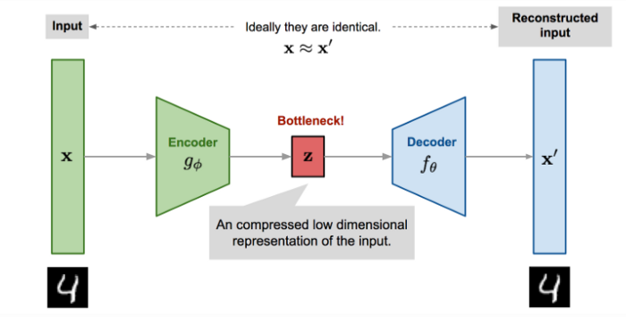
Autoencoders explained
1- Encoder: In which the model learns how to reduce the input dimensions and compress the input data into an encoded representation.
2- Bottleneck: which is the layer that contains the compressed representation of the input data. This is the lowest possible dimensions of the input data.
3- Decoder: In which the model learns how to reconstruct the data from the encoded representation to be as close to the original input as possible.
4- Reconstruction Loss: This is the method that measures measure how well the decoder is performing and how close the output is to the original input.

Slide 11
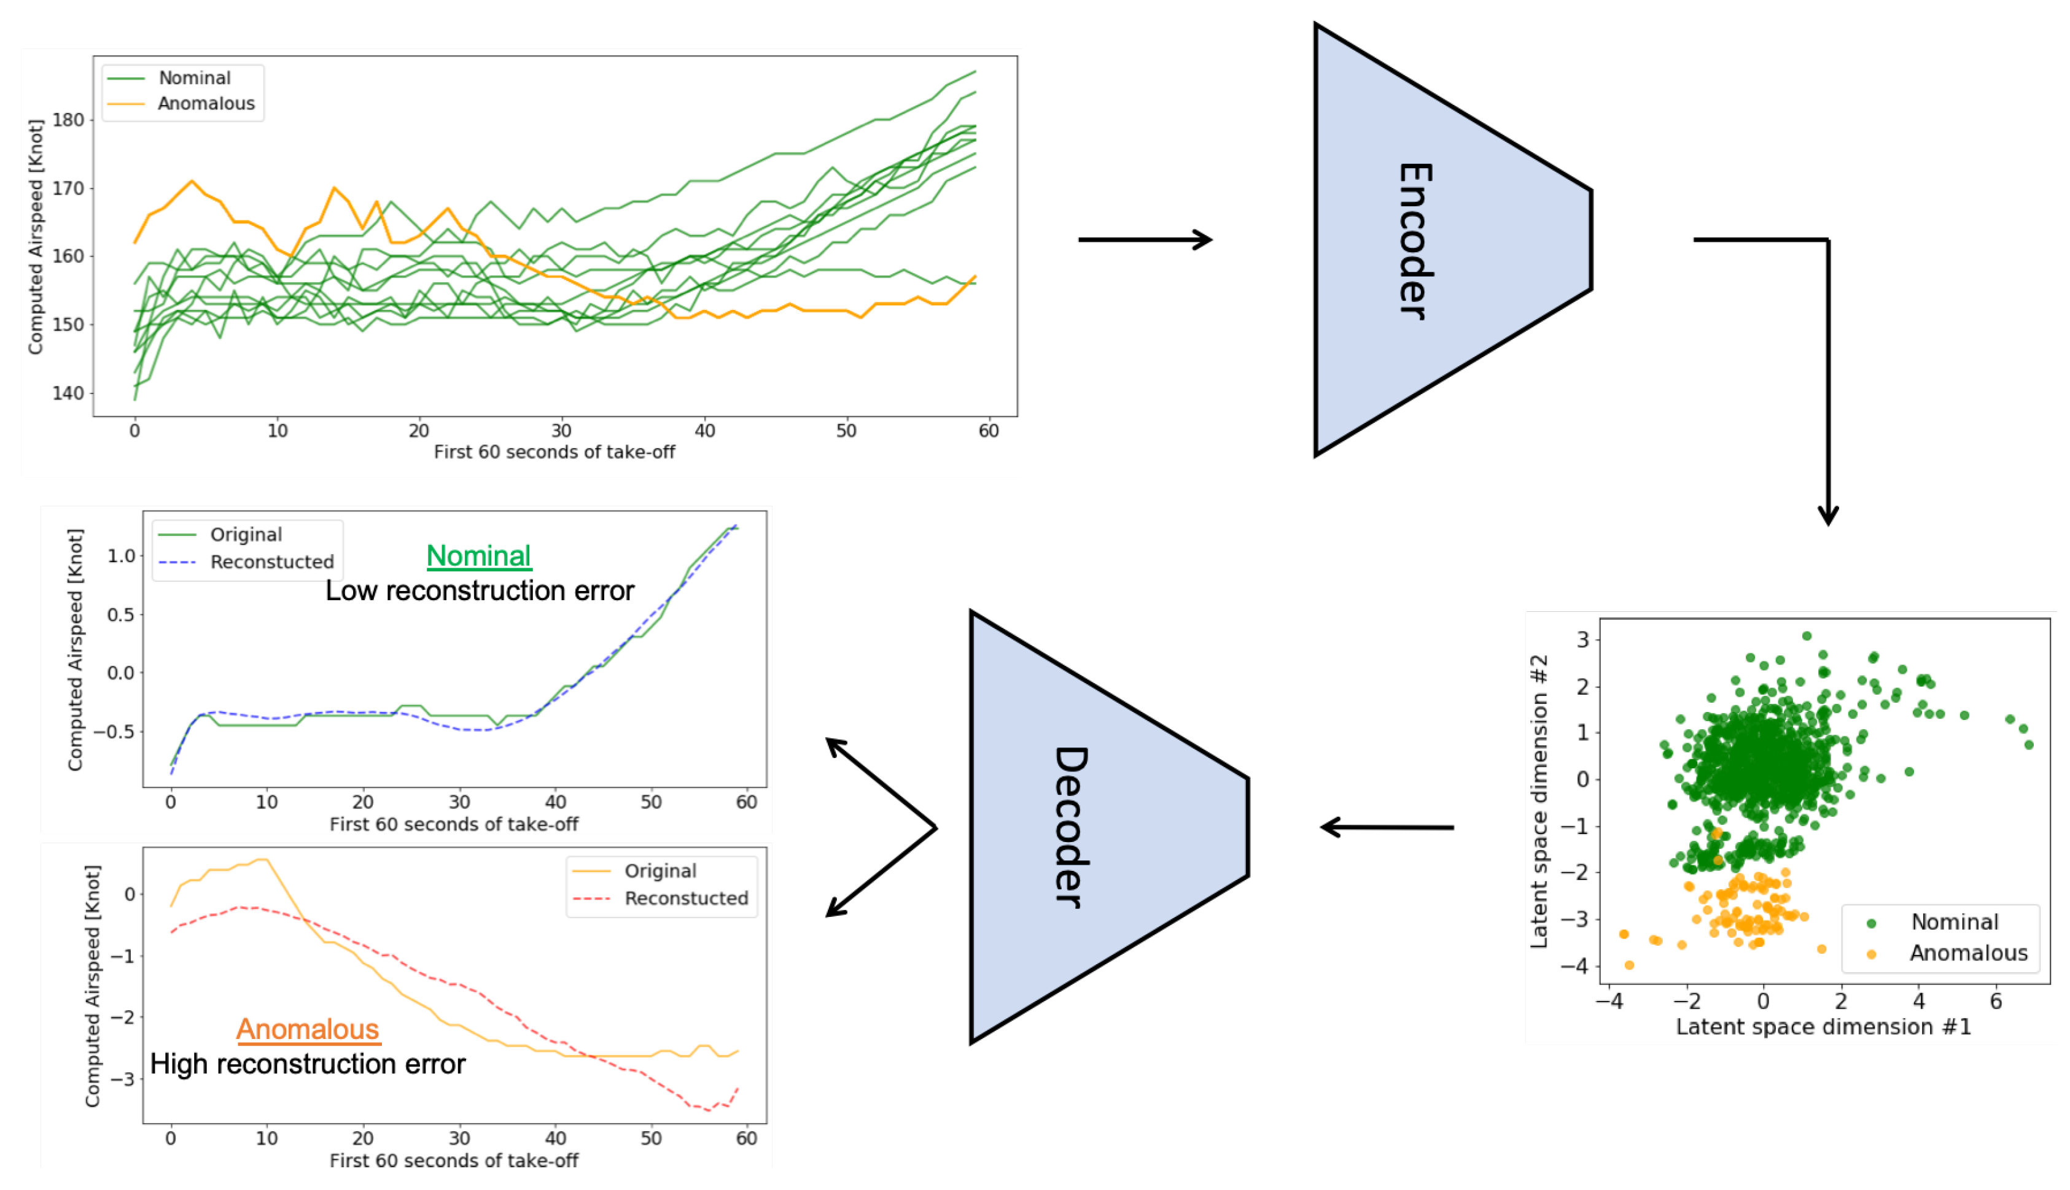
Applications of Autoencoders
Dimensionality Reduction
Image Denoising
Feature Extraction
Data Compression
Anomaly Detection
Information retrieval

Slide 12
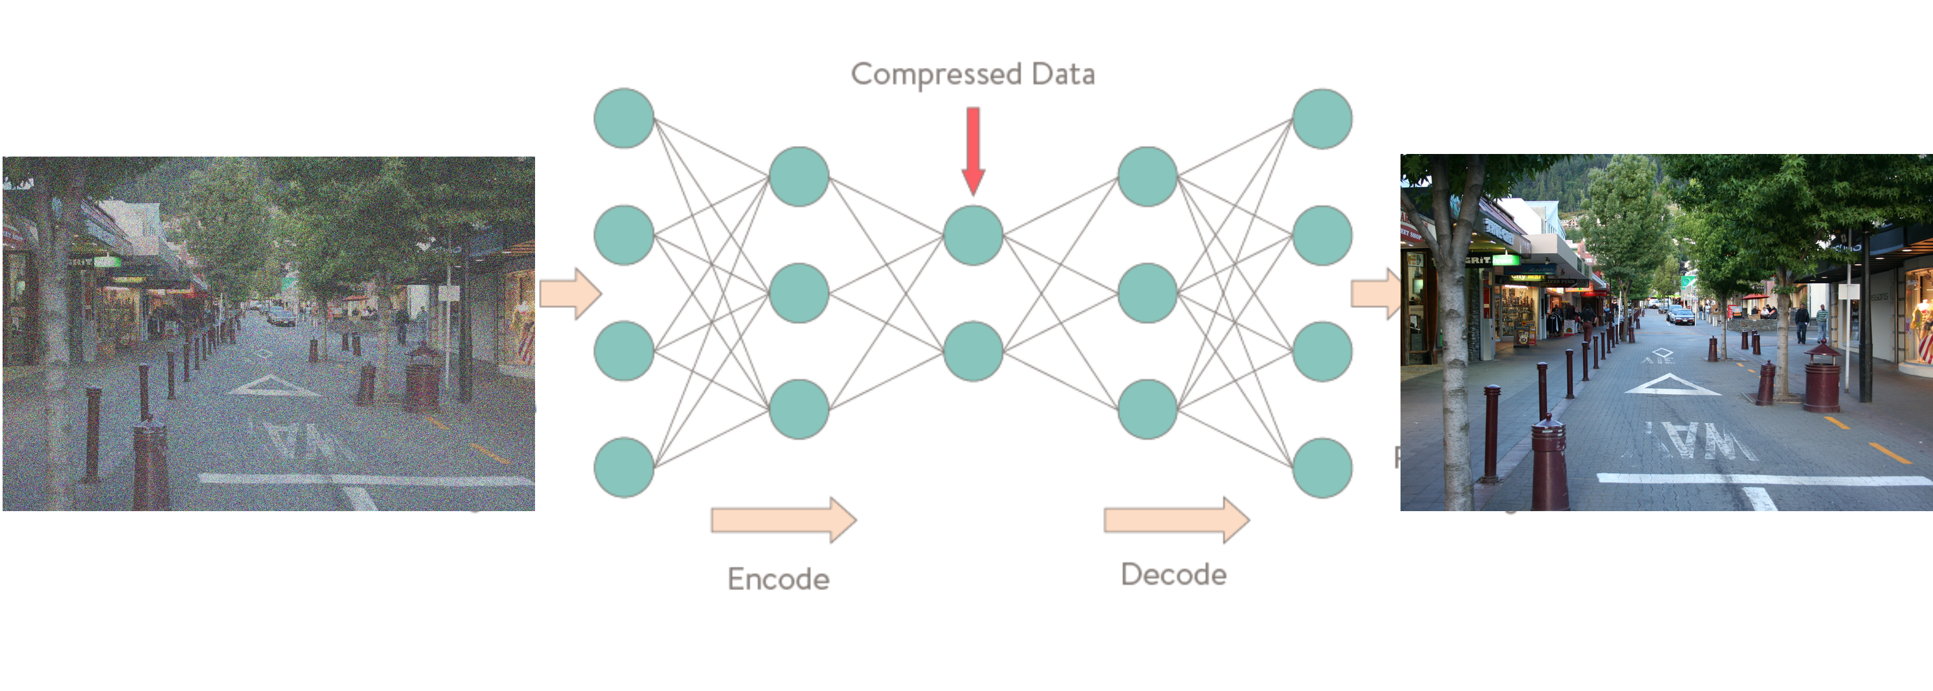
Denoising the data
Denoising or noise reduction is the process of removing noise from a signal. This can be an image, audio or a document. You can train an Autoencoder network to learn how to remove noise from pictures.
we would like to have our autoencoder is sensitive to reconstruct our latent space representation and insensitive enough to generalize the encoding of input data. One of the ways of such a method is to corrupt the input data, adding random noise to input data and then encode that corrupted data.

Slide 13
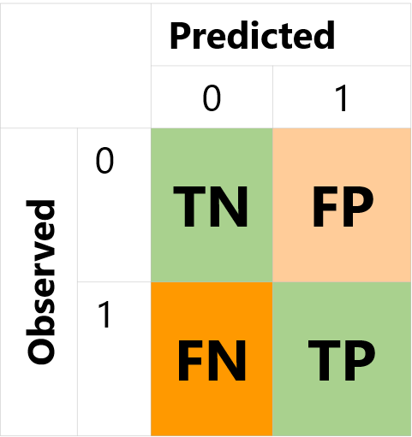
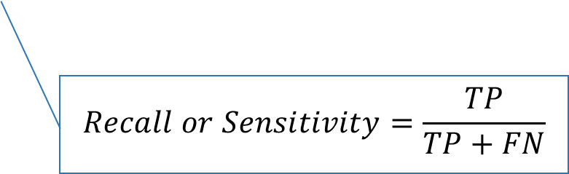
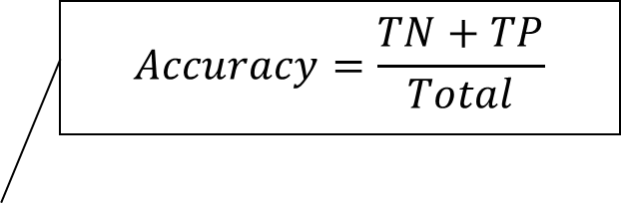

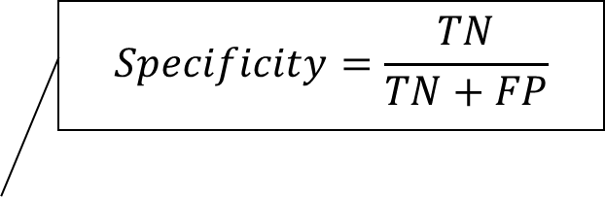
Evaluation parameters – Confusion matrix
$$Accuracy=\frac{TN+TP}{Total}$$
$$Specificity=\frac{TN}{TN+FP}$$
$$Precision=\frac{TP}{TP+FP}$$
$$Recall or Sensitivity=\frac{TP}{TP+FN}$$

Slide 14
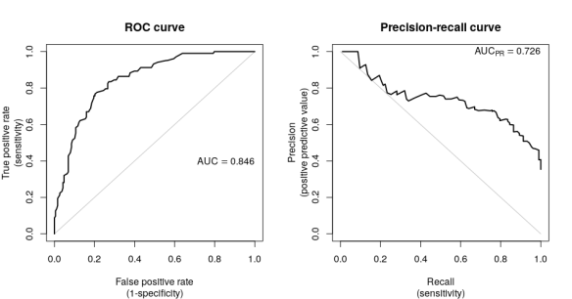
Evaluation parameters

Slide 15
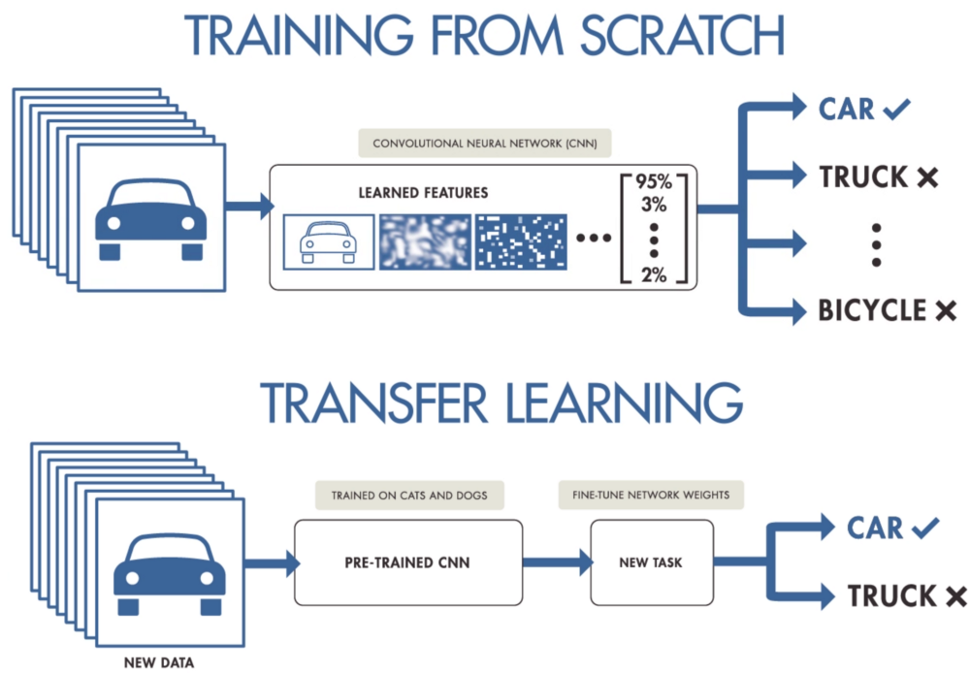
Transfer learning
Transfer learning is a machine learning method where a model developed for a task is reused as the starting point for a model on a second task.
Transfer learning will give you a trifecta of benefits: a higher starting accuracy, faster convergence and higher total accuracy

